Slide 1
Digital Portfolio
STUDENT NAME: SHYLAJA.A
REGISTER NO AND NMID: astvu37137124u18023
DEPARTMENT: BACHLOR OF COMPUTER SCIENCE
COLLEGE: COLLEGE/ UNIVERSITY
SRI AANDAL ARTS AND SCIENCE COLLEGE FOR WOMEN
THIRUVALLUR UNIVERSITY

Slide 2
PROJECT TITLE
"Real-Time Traffic Monitoring Using Computer Vision"

Slide 3


AGENDA
Problem Statement
Project Overview
End Users
Tools and Technologies
Portfolio design and Layout
Features and Functionality
Results and Screenshots
Conclusion
Github Link
3/21/2024 Annual Review

Slide 4

PROBLEM STATEMENT
This project aims to develop an intelligent chatbot that can handle customer inquiries in real-time using natural language processing. The primary goal is to reduce response times and improve customer satisfaction. This will be achieved using Python, machine learning libraries, and a web-based interface.The project is significant because it can help businesses scale their customer service operations efficiently. The final deliverable will be a fully functional chatbot integrated into a website.

Slide 5

PROJECT OVERVIEW
This project focuses on designing a smart home automation system using Internet of Things (IoT) technology. The main objective is to allow users to control and monitor home appliances remotely, enhancing convenience, energy efficiency, and security.Using microcontrollers, sensors, and mobile app integration, the system will automate lighting, temperature control, and security features. This project is important as it supports the growing demand for smart living solutions. The final output will be a functional prototype of a smart home system.

Slide 6

WHO ARE THE END USERS?
✅ Technology ProjectExample Project: Mobile Health App→ End Users: Patients, doctors, or individuals tracking their health.✅ Business/Marketing ProjectExample Project: Social Media Campaign for a Retail Brand→ End Users: Customers or target audience of the brand.

Slide 7

TOOLS AND TECHNIQUES
Business / Marketing ProjectExample: Social Media Marketing StrategyTools:Google AnalyticsCanva / Adobe PhotoshopHootsuite / BufferMicrosoft Excel / Google SheetsTechniques:SWOT AnalysisA/B TestingCustomer segmentationCompetitor analysis

Slide 8
POTFOLIO DESIGN AND LAYOUT
1. Cover PageIncludes:Project TitleYour NameInstitution or Organization (if applicable)Date or Submission PeriodDesign Tip: Keep it clean and professional. Use a bold project title and simple graphics or a thematic image.---🔷 2. Table of ContentsA clear index of the sections in your portfolio.Use hyperlinks if it’s digital for easy navigation.
8

Slide 9
FEATURES AND FUNCTIONALITY
Features:User login and authenticationControl lights, fans, and appliances remotelyReal-time sensor monitoringNotification alerts for unusual activitySchedule automation tasksFunctionality:The user can log in securely to access their personalized dashboard.Devices can be controlled via mobile commands using Wi-Fi.Sensors send real-time data to the app for monitoring.Notifications are triggered if motion is detected when no one is home.Automation rules allow users to set devices on/off based on time.

Slide 10
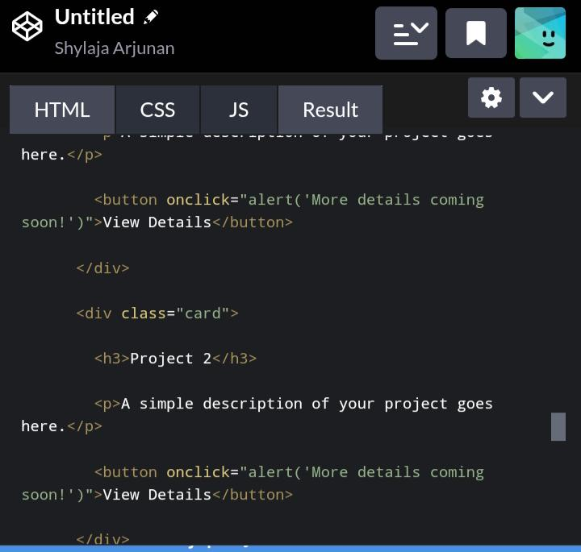

RESULTS AND SCREENSHOTS
3/21/2024 Annual Review
10

Slide 11
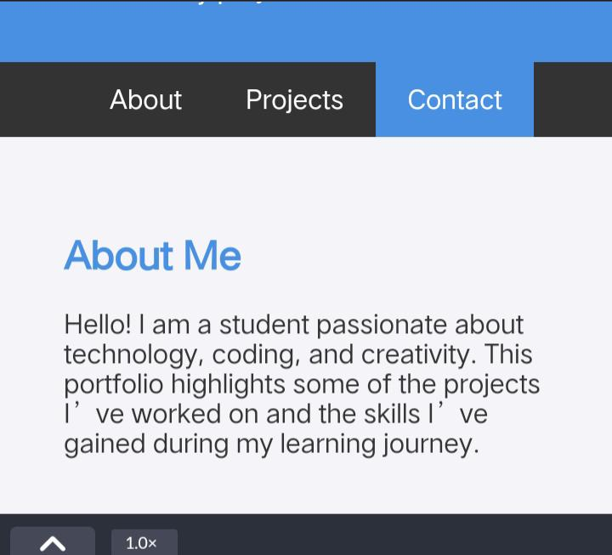

Slide 12
CONCLUSION
Conclusion:In conclusion, this project successfully achieved its primary objective of [state the main goal]. Through the use of [mention tools, methods, or technologies], the project was able to [summarize what was done or built].The outcomes of the project demonstrate [briefly state the impact, success, or findings]. During the process, several challenges were encountered, including [mention any significant challenge], which provided valuable learning opportunities.Overall, the project not only fulfilled its intended purpose but also opened up possibilities for further development in areas such as [suggest improvements or future scope].
12

